Slide 1
Optimizing Credit Risk Assessment: Leveraging Customer Segmentation, Fraud Detection, and Default Risk Analysis
IST – 718 Big Data Analytics - Syracuse University
Melissa Mosier and Sintia Stabel
Notes:
Hello everyone – Melissa and I will be presenting on the topic: “ Optimizing Credit Risk Assessment” – Leveraging Customer Segmentation, Fraud Detection and Default Risk Analysis.

Slide 2
Introduction
Exploring innovative approaches in credit risk assessment to enhance understanding of customers' credit behavior.
Examining the potential of customer segmentation, fraud detection, and default risk analysis as powerful tools in credit risk assessment.
Gaining valuable insights into distinct customer groups with similar credit behavior patterns through customer segmentation.
Detecting potential instances of fraudulent activities using advanced fraud detection techniques.
Refining credit risk models, fortifying risk management strategies, and optimizing lending policies and procedures for informed decision-making
Notes:
For the next 15 min we will be exploring some innovative approaches in credit risk assessment which can help us understand customer’s credit risk behavior.
We will Explore powerful techniques to help us gain insights into the distinct groups of customers who display similar credit behavior patterns through Customer Segmentation.
We will also predict the likelihood of a customer defaulting on a payments, and we will examine instances of fraudulent activities, to ultimately understand how these models and techniques can serve to improve the overall credit risk assessment.

Slide 3

About the Data
Obtained data from Kaggle.com containing credit card datasets for analysis.
Minimal cleaning was required as the data was already in a structured format within the CSV files.
Pre-processing steps included filling in missing values, data transformation, and normalization to ensure data quality and consistency.
Notes:
We had a total of 4 data sets, all of which were obtained from the Kaggle website. The smallest having just under 9 thousand rows and 28 columns, and the largest containing 30 thousand rows and 19 columns.
All came in csv format and required minimal cleaning and transformation. Nothing beyond the usual Fillna() for missing values. As far as transformations, most involved transforming categorical variables into their binary forms of 0s or 1s.

Slide 4
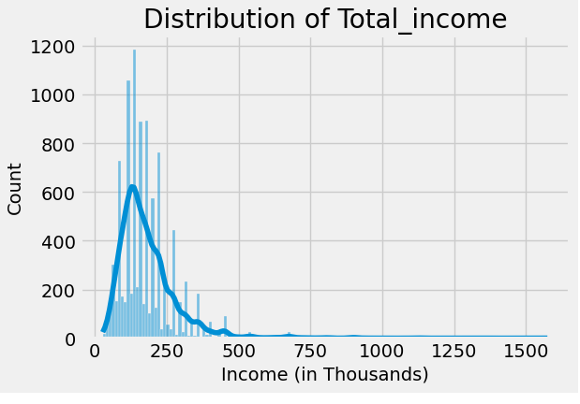
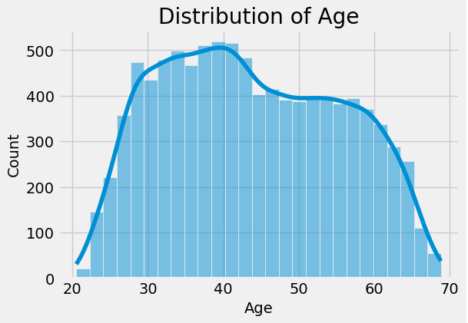
Customer Segmentation and Credit Approval Analysis
Income range of min income 27K, max 1.575 Mill. The average income of approved customers was 186 K
Age is evenly distributed with a mean age of 41.2 years
Notes:
For customer segmentation we used a dataset that included Variables such as property ownership, marital status, family size, annual income, and years employed. The target variable determined which customers were approved for credit and therefore was used the dependent variable used to evaluate our models’ performance.
Before jumping into the segmentation analysis results, here is a quick look into the income and age distribution of our dataset. The income ranges from 27 thousand all the way to 1.5 million. The average age of the approved customers is 41.2 years. Various Exploratory analysis showed that the majority of the customer who have been approved for credit on this dataset Owned a home, were employed, were married and had a median income of $157,500.00

Slide 5
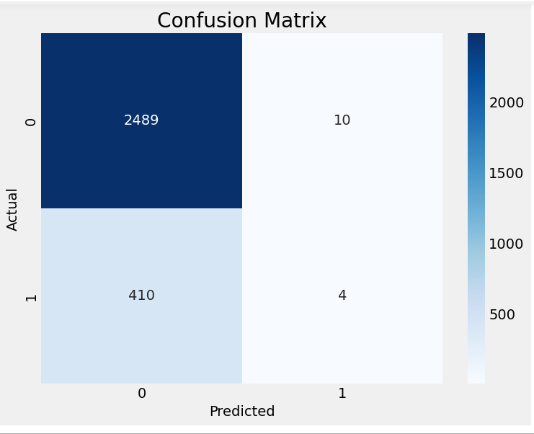
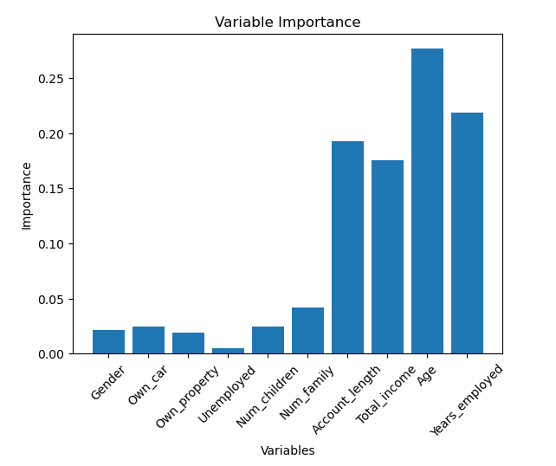
Random Forest for Segmentation
The data is split into training and testing sets using 50% split.
The classification report showed an overall accuracy of 0.86
Model performed well to predict non-approval(class 0) and struggled to predict approval(class 1)
Second run of model using 10k trees and split of 60-40 resulted in 0.85 accuracy
Most important Features were age, years employed, and account length
Notes:
For our first model we used the ensemble model Random Forest, because of its ability to handle complex relationships between features and class labels while mitigating the risk of overfitting. It does this by aggregating predictions from multiple decision trees, reducing the impact of individual trees' biases and errors, leading to more robust and accurate results
We split into 50% training and 50% testing. The outcome of the model produced an accuracy score of was 0.86. If you look at the heat map, the model did well with class 0 which not approved but it struggled to identify instances of credit approval (class 1).
In a second run of the model using 10,000 (the standard is 1000) trees and a data split of 60 – 40 the results did not improve but rather diminished slightly to 0.85 from 0.86. If you are wondering why the large allocation for the testing set as we usually see 80 20 splits – this was due to our data being highly unbalanced. Meaning - the number of 0s is much greater than the number of 1s in a ratio of 6.5 to 1
The second chart is showing the feature importance which showed that AGE, Years Employed and Account Length were the most important variables in the analysis.

Slide 6
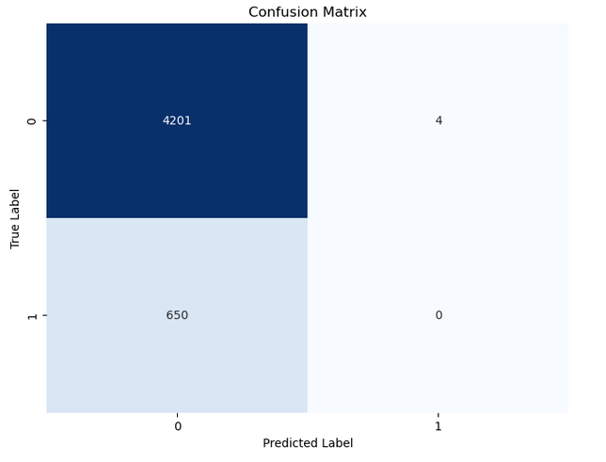
XGBoost Regression - Segmentation
XGBoost (Extreme Gradient Boosting) belongs to the family of gradient boosting methods
Training and testing split were changed to 60 - 40%.
The classification report showed an overall accuracy of 0.86
Model performed well to predict non-approval(class 0) and struggled to predict approval(class 1)
Notes:
We also applied a second model to this dataset, a model called XGBoost which is a machine learning algorithm used for regression and classification tasks. Its ANOTHER ensemble model that involves training multiple weak models, also known as base learners, and combining their predictions to produce a final prediction. Each weak model focuses on different aspects of the data and learns from the mistakes made by the previous models. However, despite the model's reputation and capabilities, it also only produced 86% accuracy and it struggle to predict True positives.
In summary:
True Positive (TP): Correctly predicted positive instances.
False Positive (FP): Incorrectly predicted positive instances.
True Negative (TN): Correctly predicted negative instances.
False Negative (FN): Incorrectly predicted negative instances.

Slide 7
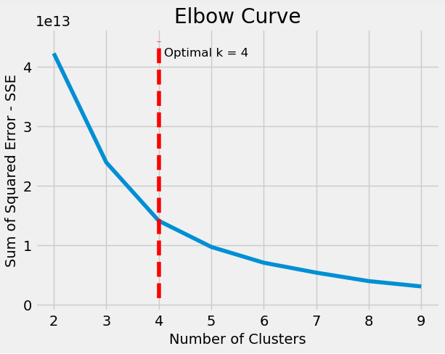
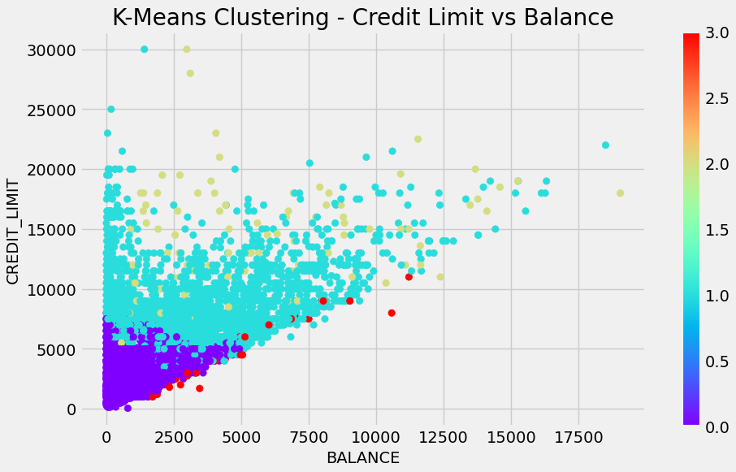
K-Means Clustering
Notes:
Next, we used K-means clustering to identify groups of customers with similar demographics, purchasing habits, or credit behaviors.
By clustering customers based on these attributes, creditors can gain insights into different customer segments and tailor their marketing, product offerings, and credit risk assessment strategies to each segment's specific needs and risk profiles.
The KneeLocator was used to identify the "knee" or "elbow" point in a curve, which represents a sudden change in slope or curvature. It is commonly used in K-means machine learning model to determine the optimal number of clusters. – 4 distinct groups of customers were isolated from this data. The plot is showing the customer distribution in terms of balance and credit limit.

Slide 8
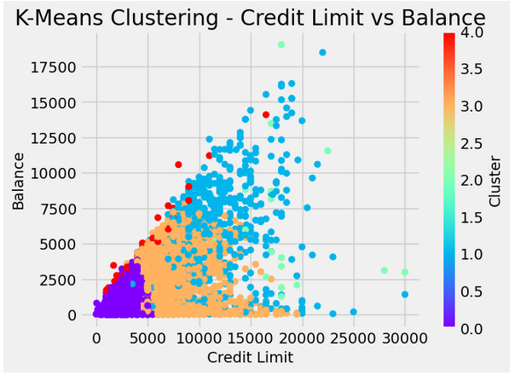
K-means classification based on credit behavior
clusters of customers with similar credit and purchasing patterns.
Creditors can tailor to their strategies and improve the customization of lending practices.
Different spending behaviors, purchase frequency, reliance on cash advances, and payment patterns are among the factors considered in segmenting customers.
Understanding these customer segments helps optimize risk assessments, customize marketing strategies, and develop targeted approaches for each cluster.
Notes:
The dataset used for this analysis includes various features related to customers' credit and purchasing behaviors, such as balance, purchase amounts, cash advances, and payment patterns.
Customers who exhibit different spending behaviors, customers who frequently make purchases, and customers who rely more on cash advances or have minimal purchase activity are some of the behaviors that can provide creditors with insight to further improve the customization of lending practices.
The same applies to groups of customers with varying payment patterns, such as those who consistently make full payments versus those who make minimum payments.
By understanding these distinct customer segments, creditors can optimize their risk assessments. For instance, they can offer personalized credit limits, specific promotions, or tailored payment plans to better suit the preferences and needs of each customer group.

Slide 9
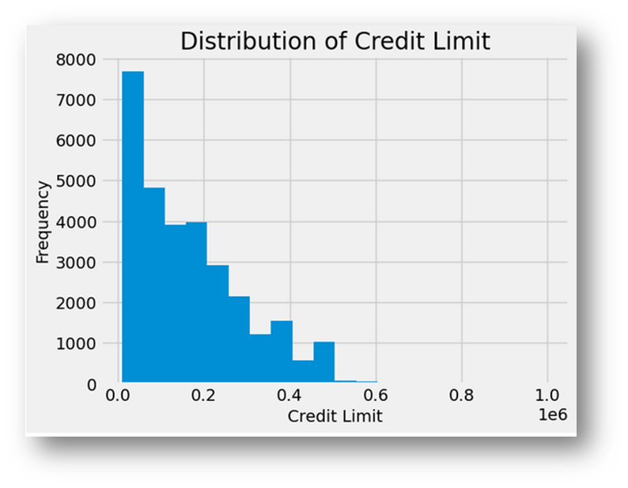
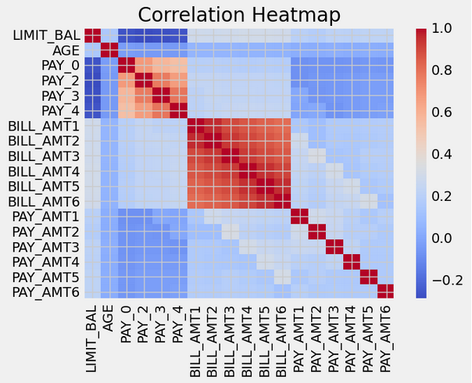
Risk of Default Analysis
Heat map suggests stronger correlations between the payment and bills variables, as well as age and balance limit
The bulk of the credit limit ranges from 24 to 25 thousand
Notes:
For our default risk analysis, we used a data set with purchase and payment behaviors
The heat map showing is showing strong correlations between payments and billing variables . There is also a somewhat strong correlation between age and credit limit – which makes sense as older people have longer credit histories.

Slide 10
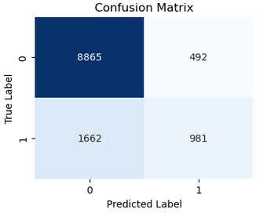
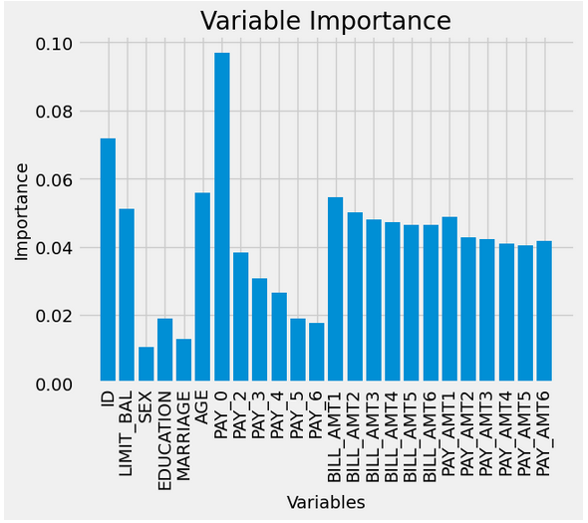
Customer Classification based on Default Risk
The data is split into training and testing sets using 40-60% split.
The classification report showed an overall accuracy of 0.82
Model performed well to predict non-approval(class 0) and struggled to predict approval(class 1)
Oversampling and Class Weighting used to solve unbalanced data issues
Most important Features were payment 0, bill 1, followed by age
Notes:
Risk of default is another important metric because creditors want to allocate their resources effectively and reduce risk by employing early interventions, when necessary,
customers at higher risk of default can be offered financial counseling or modified payment plans to prevent defaults and improve customer relationships.
For this analysis we tried several different models, including K-Nearest Neighbors and Supervised Vector Machines but the best results were once again obtained using XGBooster with a 40 60% data split. Again, the model continues to struggle to predict true positives
We tried to Improve our unbalanced data issue using techniques like over Oversampling and Class Weighting.
Oversampling randomly increases the representation of the minority class by duplicating instances or generating synthetic samples, allowing the model to learn from both classes more effectively and improve performance.
Class weighting assigns higher weights to the minority class during model training. It helps the model give more importance to the minority class, allowing it to learn from both classes and make more balanced predictions.

Slide 11

Credit Card Fraud
Goals were to
Identify fraudulent activities, and
Find factors that could indicate said activities
Found no indicators, but built a model to identify fraud.

Slide 12
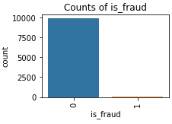
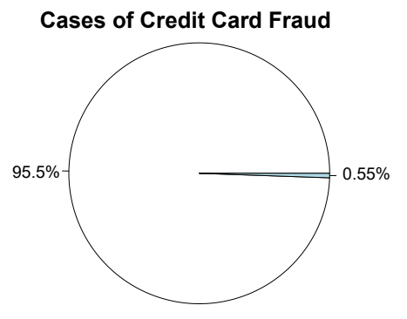
Cleaning
Weighting?
Handling datetime
Trans_date_trans_time
Convert dob to Age
Categorical > Numeric Variables
Couldn’t dummy “job” (473) or “merchant” (693)

Slide 13
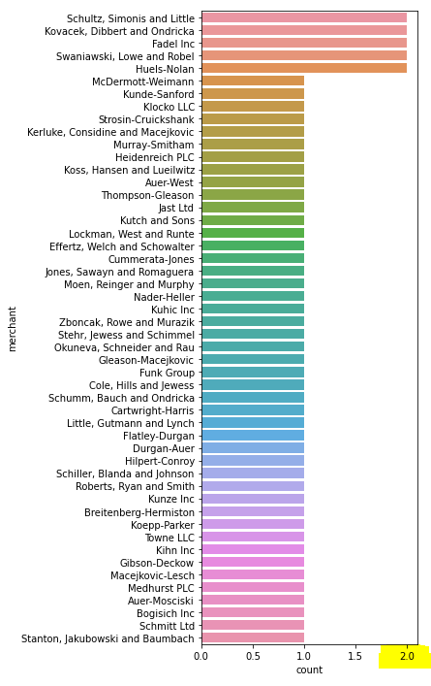
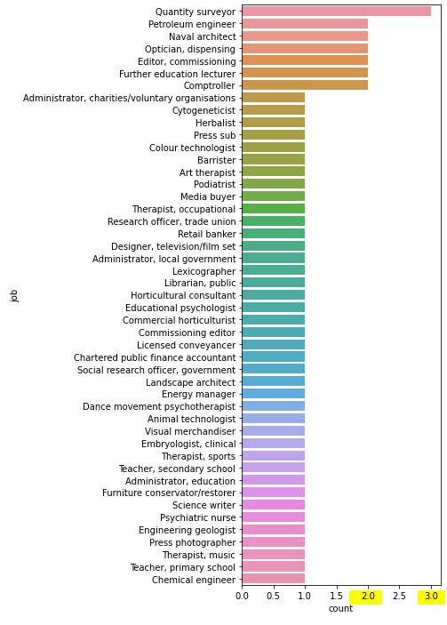
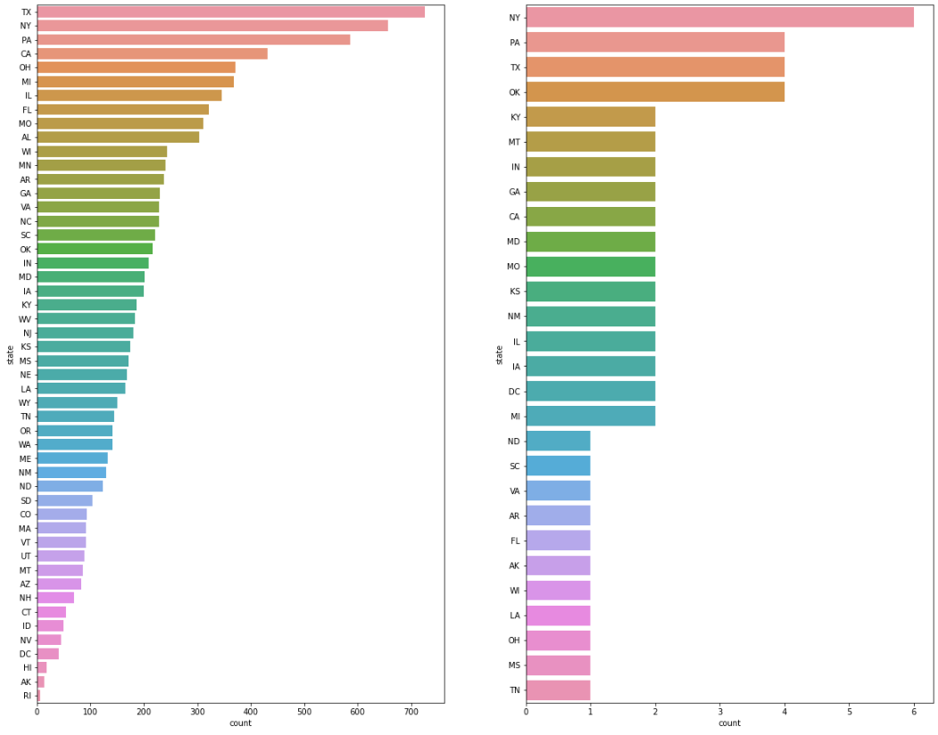
Categorical
Merchant
Job
State
No trends

Slide 14
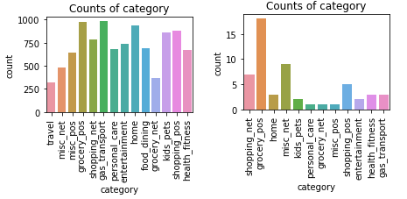
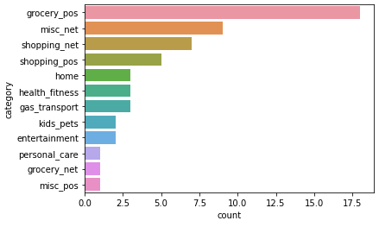
Categories
Interesting that groceries were a common purchase with fraudulent transactions.
Otherwise, predictably, online purchases.

Slide 15
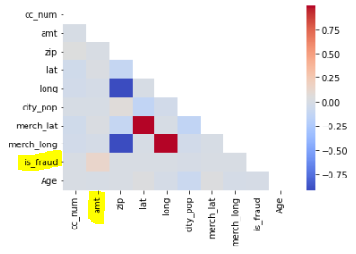
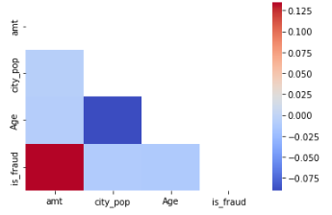
Correlations
The one thing that is for sure: People are spending MONEY when engaging in fraudulent activity.
Show them the R!
And more than likely they are making those purchases online.

Slide 16
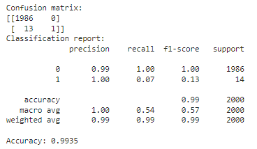
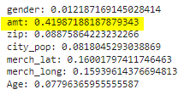
Random Forest Model
Model was able to predict fraud
Amount
Merch
Zip, city pop

Slide 17
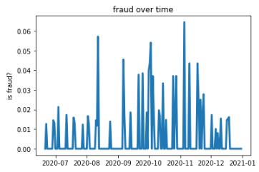
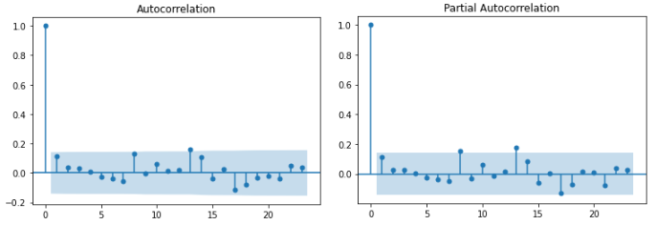
Time Series
From end of June, 2020 to December, 2021
Thought we saw trends, apparently not.
ADF = -12
Lack of data

Slide 18
Conclusions
Approval: 186k income, 41 years
Age, years employed, account length
Approval depends on customers who…
Exhibit different spending behaviors
Frequently make purchases
Rely more on cash advances
Have minimal purchase activity
Consistently make full payments versus those who make minimum payments.
Risk of default:
Payment and bills variables
Age and balance limit
Fraud can’t be reliably predicted
Jury is still out on time of year
Amount and category can indicate fraud

